Slide 1

Superstore Sales Analysis and
Forecasting in USA
TEAM 2
Andre Noviansyah
Denta Winardi
Roy Binsar Sinaga
Shaltsa Nadya
Suci Eka Azhari
‹#›

Slide 2
Presentation Outline
Background and Objective
Exploratory Data Analysis
Conclusion
1
3
5
2
4
6
Modelling
Action Item
Marketing Campaign
Business Strategy
Data Preprocessing

Slide 3
Background and Objective
1

Slide 4
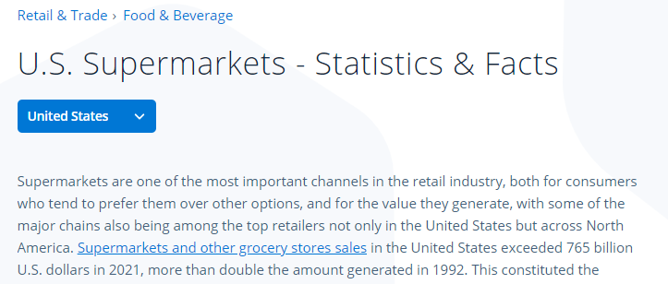
Background and Objective
Source: Statista (2022)

Slide 5
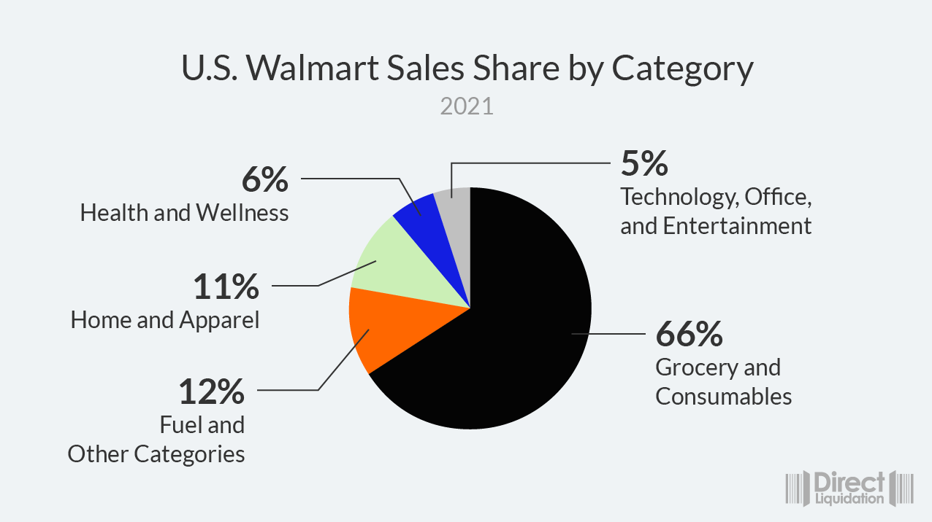
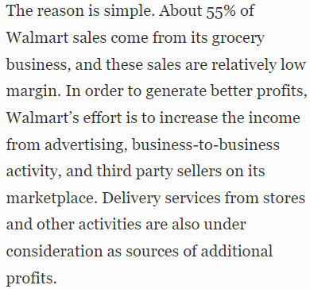
Background and Objective
Source: Forbes (2023)

Slide 6
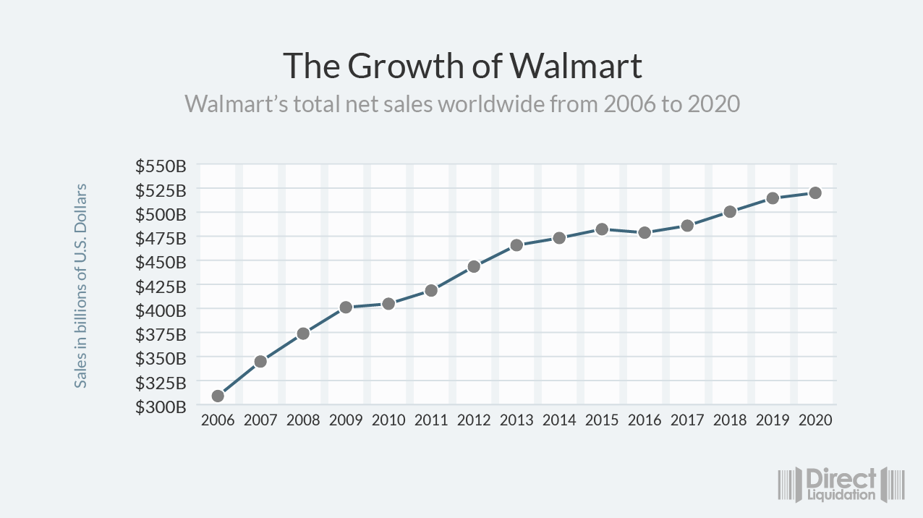
Background and Objective

Slide 7
Goals:
Problem Statement:
Forecast future Revenue.
Adjust Business strategy & Marketing Campaign.
Maximize marketing budget or Maintain annual Revenue growth YoY.
How to improve Business Problems?
What is the effective action item?
Does the action item worth implementation?

Slide 8
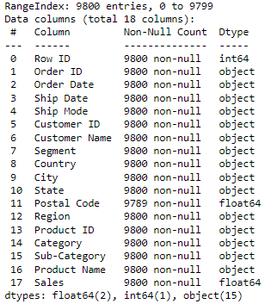

Dataset Information
Missing Value and Duplicated Value
9.800 rows
18 features
Row ID
Order ID
Order Date
Ship Date
Ship Mode
Customer ID
Customer Name
Segment
Country
10. City
11. State
12. Postal Code
13. Region
14. Product ID
15. Category
16. Sub-Category
17. Product Name
18. Sales

Slide 9
Data Preprocessing
2

Slide 10
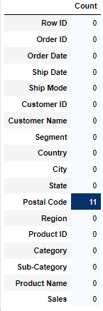
Missing Value
Duplicated Value
Handling Duplicated and Missing Value
There is 11 missing value in Postal Code Column
1 value
Drop duplicated value
Drop Postal Code Column

Slide 11
Exploratory Data Analysis
3

Slide 12
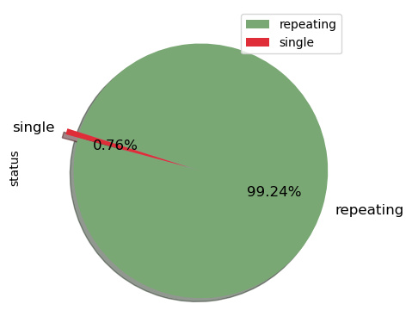
Customer Analysis
Total Revenue: $ 2.261.255 Mn
Total Customer :
793
Single: 6
Repeating: 787

Slide 13
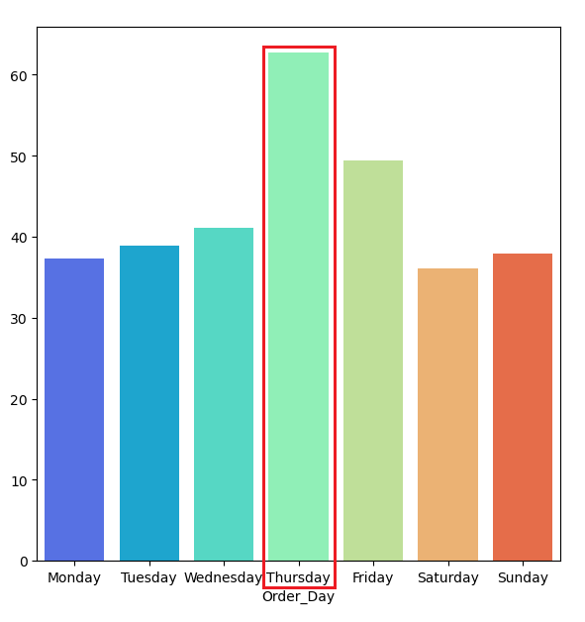
Trend Analysis
Promotions and discounts on Thursdays, which can attract many buyers.

Slide 14
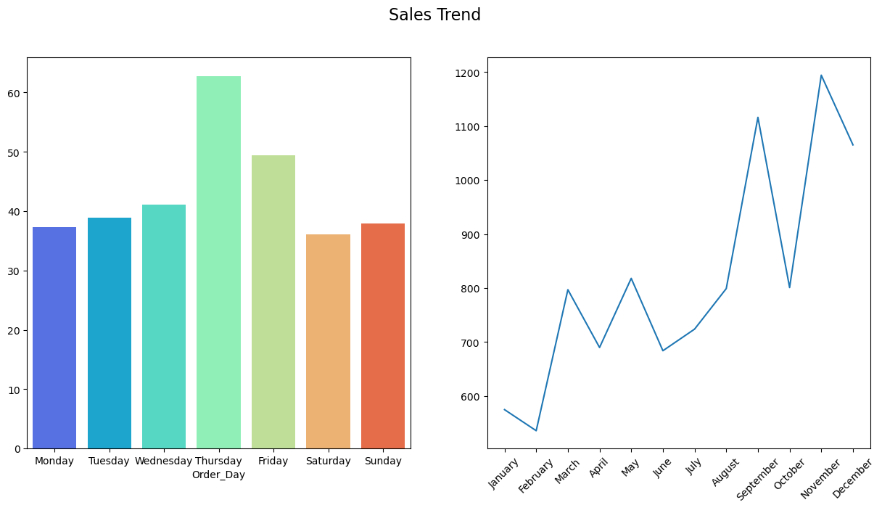
November receives the highest revenue due to Thanksgiving Day.
February earns the least revenue due to the winter season and the absence of significant national holidays.
October experiences a decline in revenue due to the end of summer, as people return to their daily routines.

Slide 15
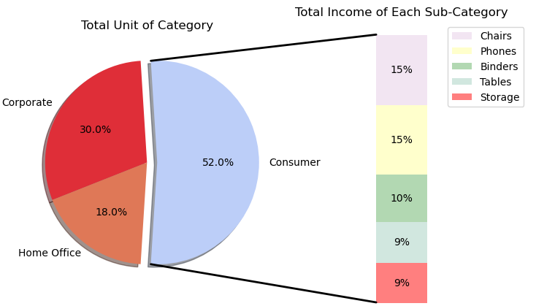
Category Analysis
Consumer category has generated the highest revenue among several sub-categories.
Phone has the potential to increase profits for various marketing campaigns.

Slide 16
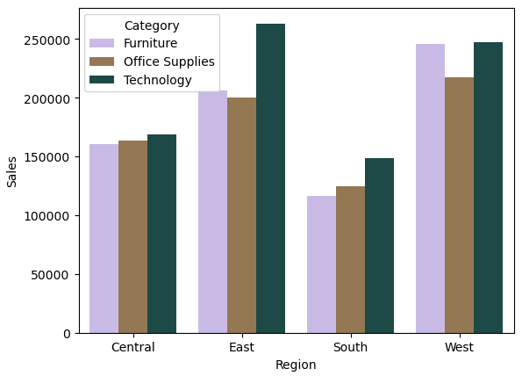
Region Analysis
West region is the most highest sales among another region.
The technology was highest category revenue across all regions.

Slide 17
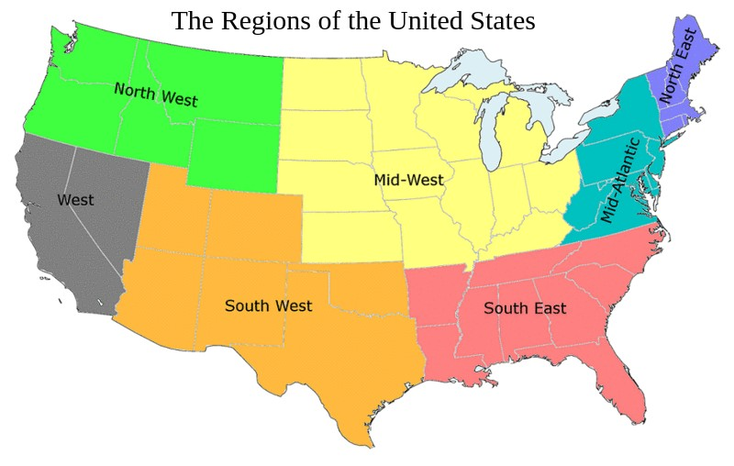
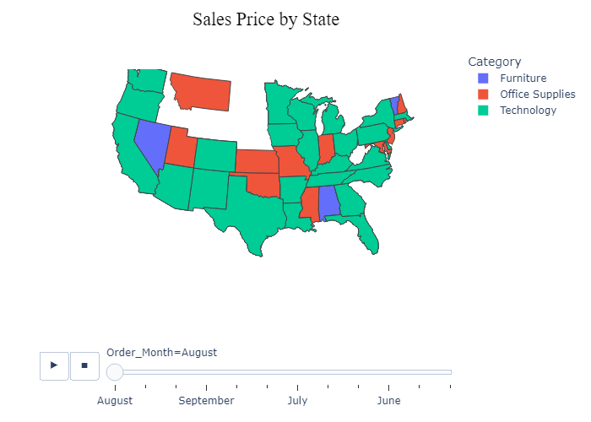
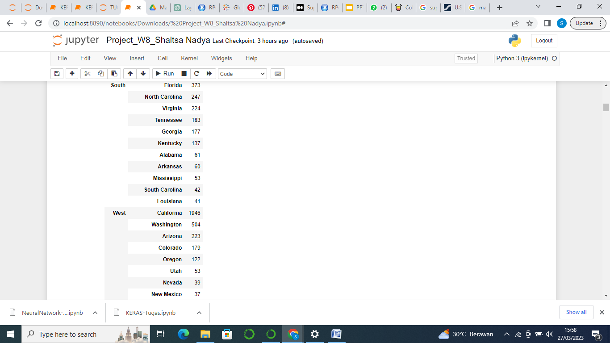
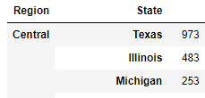
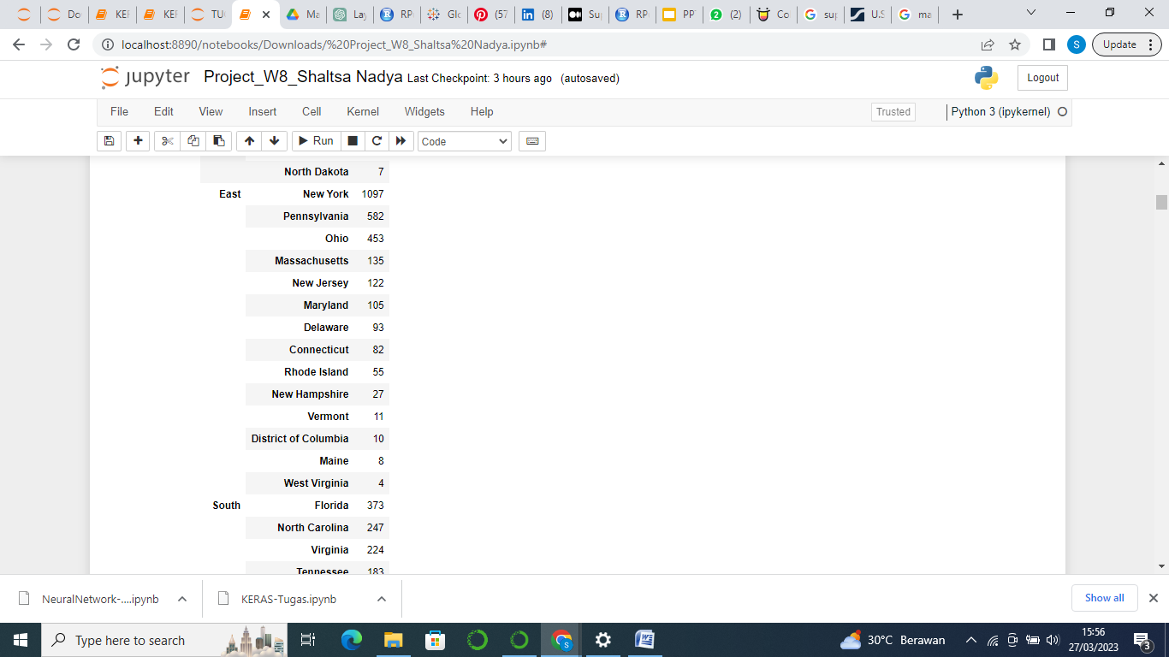
Region by Category

Slide 18
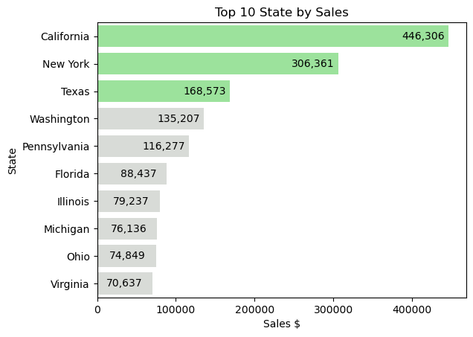
State Analysis
California is a global technology hub and home to many leading technology companies.
California residents often have higher incomes, have a larger budget for purchasing technology products.

Slide 19
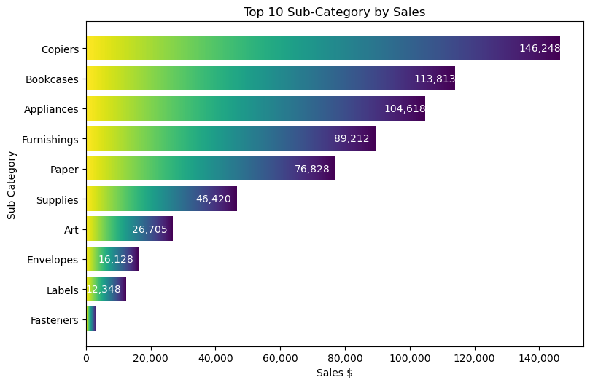
Sub-Category Analysis
The copiers generate the most revenue due to the increasing demand for office supplies​.

Slide 20
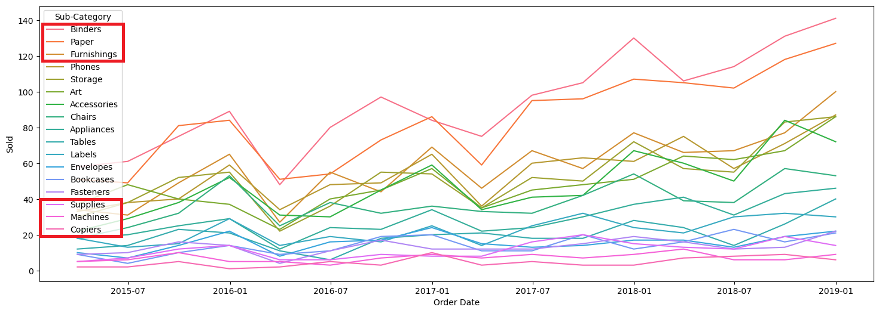
Binders and paper became the most bought-after items from 2015-2018 During this period, the US economy was growing steadily with an increase in employment.

Slide 21
Modelling
4

Slide 22
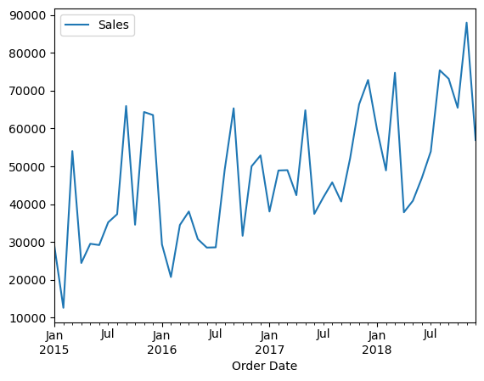
Pattern per Month

Slide 23
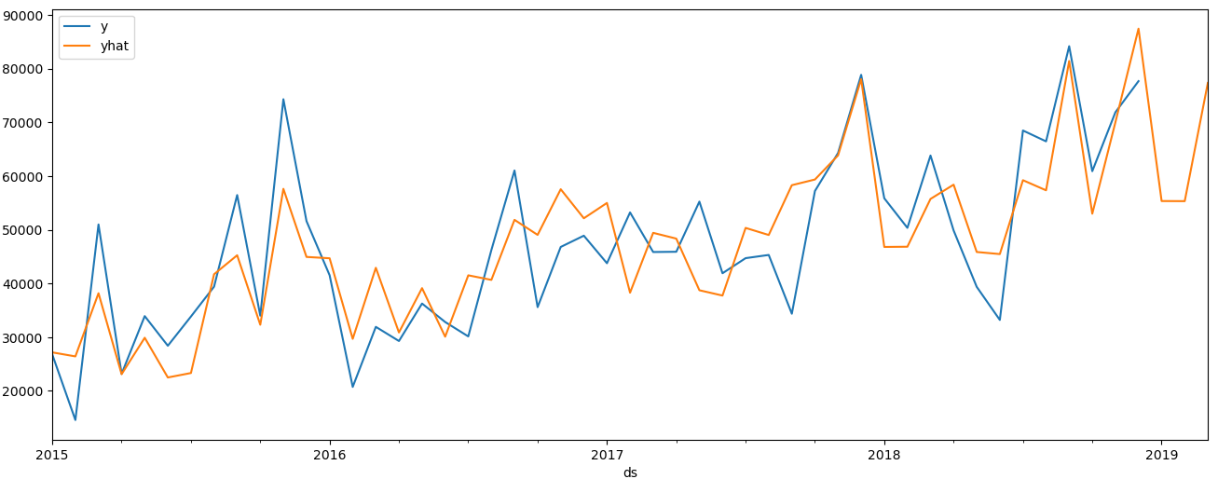
Prophet Method

Slide 24
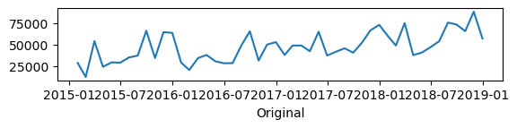
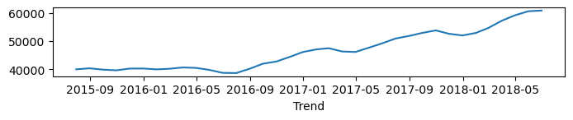
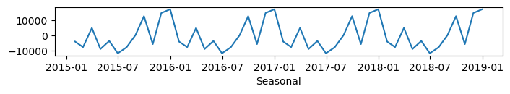
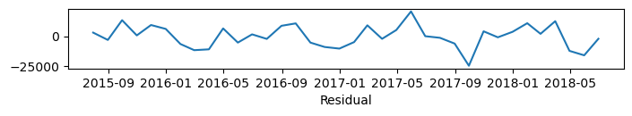
Holt Winter Exponential Smoothing Method

Slide 25
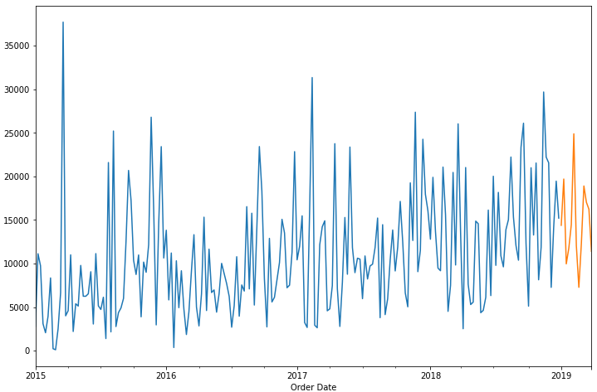
Holt Winter Exponential Smoothing

Slide 26
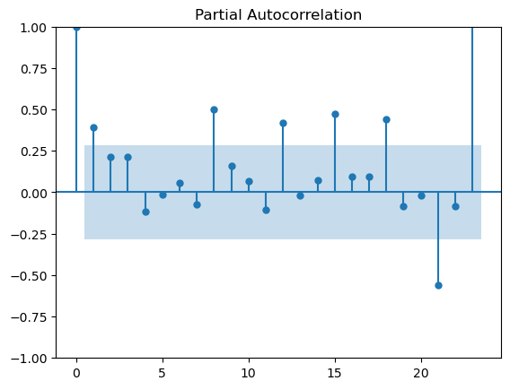
Autoregressive Method
lag = 8
Source: https://elibrary.unikom.ac.id/

Slide 27
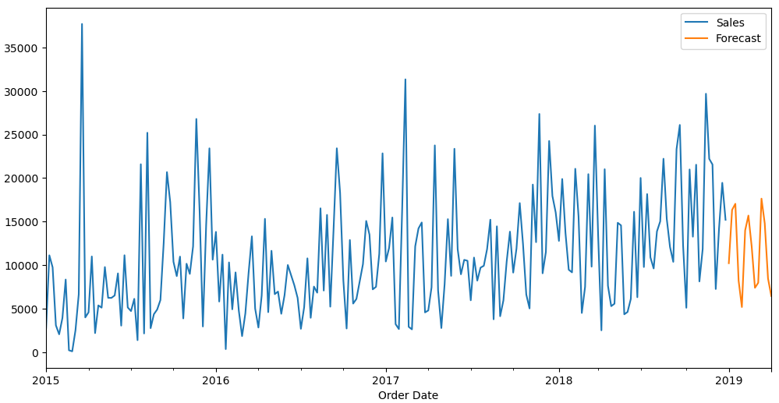
Autoregressive Method

Slide 28
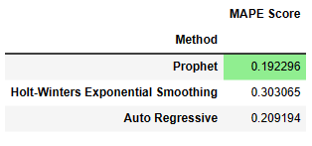
Model Comparison
Prophet has the smallest MAPE score, which shows that the Prophet model provides the most accurate results in estimating the actual value of this dataset compared to the other two methods.

Slide 29
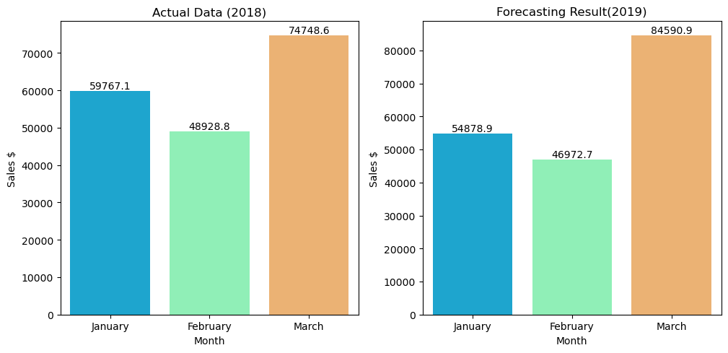
Comparison Study
Notes:
Revenue Januari dan Februari 2019 diramalkan mengalami penurunan karena kemungkinan segmentasi produk kurang tepat. Tetapi pada Maret 2019 revenue diramalkan meningkat signifikan kemungkinan karena pihak Superstore mulai mengembangkan strategi pemasaran.

Slide 30
Business Problems
Inaccurate market segmentation.
Lack of loyalty program.
Insufficient focus on selling main products.
Solutions:
Main focus in Technology Product, increase stock and Technology product Campaign (augmented reality) discount only for certain product.
Points-based system, Tiered system, Referral program, VIP program (Free shipping, or personalized discounts).
Reduce operational costs and unnecessary supplies.

Slide 31
Forecasting Result
Total Average Revenue in Previous 3 Months 2015-2018:
$ 166466.77
Total Revenue for Next 3 Months 2019 from Forecasting:
$ 186442.53
Potential Gross Profit:
12%
Notes:
Kami berusaha mempelajari gross profit berdasarkan hasil peramalan

Slide 32
Conclusion
5

Slide 33
Conclusion
Exploratory Data Analysis
Highest sales dominates by consumer segment, west region and technology,
Based on trend, highest sales are on November and Thursday.
California became the highest sales with many leading technology companies.
Model
Prophet has the lowest MAPE score of 19.22% . Prophet has better performance compared to the tuned one in this dataset.
Forecasting
Potential Gross Profit is 12%

Slide 34
Action Item
6

Slide 35

Action Item
Marketing Campaign
Holiday Season Promotion.
Create Loyalty Program for Customer .
Online Exclusive Offer.
Bussines Strategy
Information Technology (mobile applications, e-commerce platforms, Supply Chain Management (SCM) systems).
Logistic infrastruktur.
Merk Development and Marketing Campaign.
Customer Service improvements.

Slide 36
ROI Estimates
Action Item (Business Strategy) | Assumption (Investment Percentage) | Cost
Information Technology | 1.7% | $ 3169.52
Logistic Infrastructure | 10% | $ 18644.25
Merk Development and Marketing Campaign | 5.7% | $ 10627.22
Customer Service Improvements | 5.5% | $ 10254.34
Total |  | $ 42695.34
ROI : 3.36 (336,68 %)
Business strategy is Worth Implementing.

Slide 37
We have the potential revenue of $ 186,442 IDR( 2.83 Bn) and Gross Profit of 12% if we do all of the action items with ROI of 3.36 (336.68%).

Slide 38
Thanks!
Any questions ?
You can find me at
Coding For Indonesia 😉

Slide 39
References
https://nrf.com/
https://coresight.com/
https://nrf.com/
https://www2.deloitte.com/
https://www.statista.com/topics/1563/supermarkets-in-the-us/#topicOverview

